Slide 1
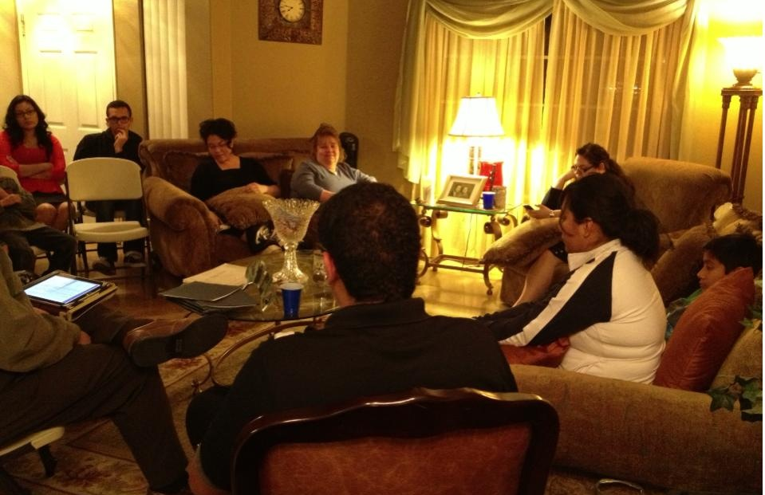
YOUTH LIFE GROUPS
5 Key Points For Successful Growth

Slide 2
1. What are Youth Life Groups
What are Life Groups
You probably heard many terms for Life Groups such as: Small Groups, Cell Groups, Home Life Groups, Home Cell Groups, Men’s Life Groups, Women’s Life Groups, etc.

Slide 3
1. What are Youth Life Groups
THE PURPOSE OF THIS GROUP IS:
1. To grow in relationship with God.
2. To grow in the relation with others.
3. To grow numerically and to multiply.

Slide 4
1. What are Youth Life Groups
The basis for meeting in groups is a reflection of the way the primitive church began to unfold following Christ’s ascension.
Acts 2:46-47 (NIV)
⁴⁶ Every day they continued to meet together in the temple courts. They broke bread in their homes and ate together with glad and sincere hearts, ⁴⁷ praising God and enjoying the favor of all the people. And the Lord added to their number daily those who were being saved.
Notes:
The Ascension of Jesus Acts 1:9-11
Following Jesus ascension the disciples meet in the upper room praying in one accord.
When the Holy Spirit fell upon them they went out into the streets to share this great news.
This was the very first Holy Ghost filled revival to the amount of 3,000 men being baptized in Jesus Name.
“Every day they continued to meet together in the temple courts. They broke bread in their homes and ate together with glad and sincere hearts, ⁴⁷ praising God and enjoying the favor of all the people. And the Lord added to their number daily those who were being saved” (Acts 2:46-47 NIV).

Slide 5
1. What are Youth Life Groups
The Need to break with tradition
This is not another social activity
This in not another initiative
Youth Life Groups are not just another THING, or PHASE or…
LIFE GROUPS ARE A CHANGE OF LIFE!

Slide 6
1. What are Youth Life Groups
Life groups are a core of understanding church community.
Work in community.
Serve in community.
Love in community.
Live in community.
What each role means in your life group community.
Notes:
Realize that small groups begin with community. Community in it basic expression means: Public, Free, Open, Society, Group
Community is a wonderful platform to develop relationships with our friends, a platform to share the Good news of our Lord and Savior Jesus Christ.

Slide 7
2. Weekly Youth Life Groups
Youth Life Groups are a Weekly commitment of:
Prayer
Fasting
Studying the Word of God
Encouraging other
Mentoring others
Sharing the Good News with our friends
Breaking bread together
Building relationships

Slide 8
3. Youth Life Groups Impact Youth
Youth Life Groups are a platform for youth to share their needs with other youth that can relate with each others
Needs
Challenges
Desires
Faults
Accomplishments.
Without a parent, adult Brother, Sister or Minister being present.
Notes:
Youth have a tendency to “shut down” when a person of authority are present mainly a Adult, parent, minister, pastor.

Slide 9
4. Typical Youth Life Group Session Guides
1. We will also share the rights of the meeting, therefore, we all will participate in providing with accommodations at the meeting from house to house every month.
2. Sharing will be in an appropriate brief form and with courtesy.
3. We will keep from telling stories that are not related to the subject.
4. We will try to be transparent and we will maintain (not share with others outside of our group) those things that are shared in the group in strict secret.
5. We will try to be as faithful as we can in our attendance and we will be in contact with the leader of the group or the assistant when we cannot attend.

Slide 10
4. Typical Youth Life Group Session Guides
6. We will make an effort to be on time and not to interrupt when we arrive late to the meeting.
7. We will finish the meetings at 9:00 p.m. and immediately we will leave to avoid inconveniences in the homes.
8. We will all participate in helping to leave the meeting place/home clean before leaving.
9. We will not speak against any religion.
10. We are a Friendship Group. Therefore, we will try to touch the hearts of our friends and brothers in Christ in order to help them to grow in their relation with God.

Slide 11
4. Typical Youth Life Group The Session
Begin by greeting individuals as they arrive and “Breaking Bread” snack and drink.
Ice Breaker: simple question that will tie to the lesson that engages comments from those present.
Sing a song and make a prayer
Begin Lesson, have others read scripture
Notes:
Youth have a tendency to “shut down” when a person of authority are present mainly a Adult, parent, minister, pastor.

Slide 12
4. Typical Youth Life Group The Session
Conclusion
Ask a few question concerning the lesson
Ask who is going to bring deserts for the following week, if you ask your new friends to bring something they feel committed to return.

Slide 13
4. Typical Youth Life Group The Session
Review typical lesson in Workbook
Notes:
Hand out lesson and go step by step

Slide 14
5. Tools For Growing Youth Life Groups
Evangelistic cycle (5 Week – Friend Day)
Review Workbook “Action Plan”
Notes:
Pass out book markers and work books.
If time permits go through workbook training.
Let them know that if they have a structure where you have a supervisor then the supervisor would walk them through the workbook.
The workbook is filled out the week before Evangelistic Cycle is launched.
The bookmarkers should reflect your 4 or 5 week cycle date and goals.

Slide 15
5. Tools For Growing Youth Life Groups
Notes:
Explain bookmarker front and back.
Front is for your friends name.
Our goal is to at least write a minimum of 3 names but 5 works best.
Through Prayer and Fasting for our written names we are confident the Lord will show each person which to focus your energy and resources on.
Back is the weekly goal.

Slide 16
5. Tools For Growing Youth Life Groups
Notes:
Explain bookmarker front and back.
Front is for your friends name.
Back is the weekly goal.

Slide 17
YOUTH LIFE GROUPS
5 Key Points For Successful Growth
Notes:
In our lifegroup 5 youth have given their life to the Lord these past 24 months and my assistant (Timothy) is now taking the lead in my life group.

Slide 18
Pastor Albert Pérez
broalp@me.com

