Slide 1
Youth Leadership: Facilitating Team Building and Communication
Pastor Rick Alvarez
Oasis Apostolic Church
rickalvarez76@gmail.com
Notes:
Welcome
Introductions
Prayer
Let’s get started
----- Meeting Notes (1/3/14 20:34) -----
2 minutes

Slide 2
Ice Breaker
Each table will have an outline of a body at your table
Each participant at your table will write one comment per part of the body on their Post-It note and place it on the body when they finish
Tape your completed body on the nearest wall
After all tables have completed their posts, walk around the room to observe what other tables have posted
Notes:
Self Introductions:
Name
Position
Church
Go through activity guidelines
Click to next slide
----- Meeting Notes (1/3/14 20:34) -----
2 minutes to explain Ice Breaker
2 minutes to introduce themselves
5 minutes for post-its & to pin on wall
3 minutes to walk around

Slide 3
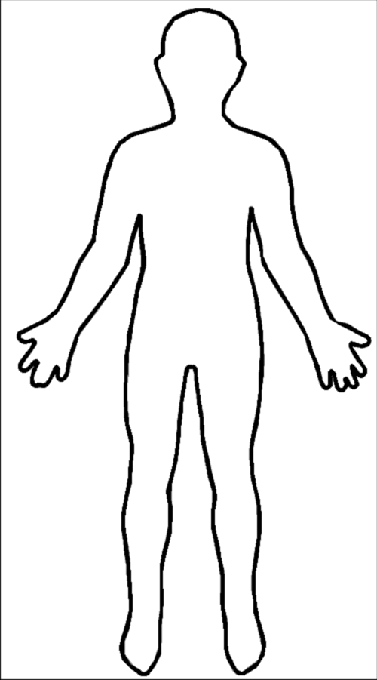
Head: dreams or goals we have (for our community)
Ears: things we like to listen to
Eyes: How we like other people to see us
Shoulders: problems we may have to face.
Heart: things we feel strongly about
Hands: things we like to make or do (with our hands)
Stomach: things we like to eat
Feet: places we would like to go
Notes:
1. Leave powerpoint on this slide until activity is completed

Slide 4
Today’s Agenda
Prayer and Introduction
Ice Breaker
Norms
Parking Lot
Group Roles
Spiritual Focus
Training Objective
Introduction to lesson with Video
Cooperative Learning Strategy
Team Building
Reflection
Notes:
Take a minute to read the agenda silently to yourselves
As you can see we have a bit to cover, but before we get into the meat of the conference, there are a few parameters we would like to cover
----- Meeting Notes (1/3/14 20:34) -----
1 minute for them to read silently

Slide 5
Training Norms
Technology to be used for workshop purposes only
There won’t be any designated break so please go as you see fit
Respectful of the opinions of others
No side-bar conversations while presenter or reporter is speaking
Respect the time-frame the presenter requests
Positive attitude with an open mind
Notes:
1. Go over Norms
----- Meeting Notes (1/3/14 20:47) -----
1 minute

Slide 6
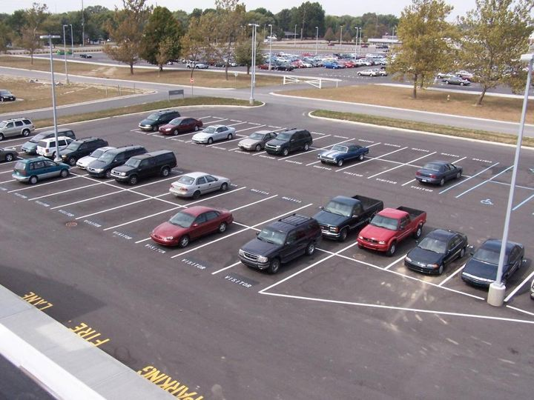
Parking Lot
Post-It pads on table
Write your question and place it on large poster.
Questions will be answered towards end of training.
Notes:
1. Explain Parking Lot concept and point to location of poster
2. Let them know they can stand up at any time as long as it is before the end of the conference
----- Meeting Notes (1/3/14 20:47) -----
1 minute

Slide 7
Group Roles
At your table choose the following roles:
Facilitator
Individual who will lead
Recorder
Individual who will record information on poster
Timekeeper
Individual who will be keeping time and notifying the group 30 seconds before time is up.
Reporter
Individual who will report back to presenter
Participant
Input in the discussions and share thoughts
Notes:
Read through Group Roles
Give them 2 minutes to select which role they will assume
If there are groups greater then 4, then the individual(s) will be a participant
----- Meeting Notes (1/3/14 20:47) -----
2 minutes to read and explain
2 minutes for table to designate roles

Slide 8
Spiritual Focus
Giving diligence to keep the unity of the Spirit in the bond of peace.
Ephesians 4:3
Think-Pair-Share Directions:
With your elbow partner, analyze the verse
Answer the prompt –What does the verse mean in terms of your leadership position?(3 minutes)
Share your opinions with those at your table; everyone must participate. (2 minutes)
Notes:
1. Read the verse out loud and continue with activity
----- Meeting Notes (1/3/14 20:47) -----
1 minute read and direct
3 minutes to answer prompt
2 minutes to share out at table

Slide 9
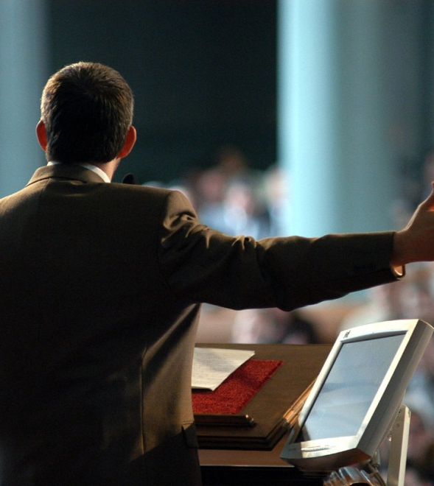
Training Objective
Youth Leaders will learn how to use Cooperative Grouping and Team Building in order to build open communication and trust in their youth groups.
Notes:
Believe it or not, we are now at the beginning of our actual conference.
This is the outcome we expect for today. We hope this will be a blessing to you as a youth leader. For your church and your young people.
Read the Training Objective out loud
----- Meeting Notes (1/3/14 20:47) -----
1 minute

Slide 10
Open Communication
Team Building Activities
Positive Relationships
Trust
Open Communication
Notes:
Open communication comes from trust.
Trust comes from building positive relationships
Articulated team building activities help build positive relationships.
Our hope is that by providing you with team building strategies you will be able to create open and honest communication among your local youth group.
----- Meeting Notes (1/3/14 20:47) -----
1 minutes

Slide 11
Assumption for Spiritual Foundation
Fasting – Prayer – Worship – Word
Traditional
Youth services
Prayer night
Bible study Group
Contemporary
Youth cell groups
Youth nights
Lock-ins
Notes:
I am making a major assumption that: Given we have an established spiritual foundation, we have already incorporated the following:
Read the slide out loud
Let’s watch the following video. (next slide)
----- Meeting Notes (1/3/14 20:47) -----
1 minutes

Slide 12
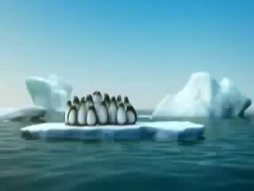
Notes:
----- Meeting Notes (1/3/14 20:47) -----
30 seconds

Slide 13
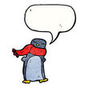
Share Out Reflection
Reflection Activity
Verbally share out any thoughts about what the video means
Write down any ideas derived from it.
Notes:
Let’s reflect. What do you think about the video?
As others are sharing, you may write down any thoughts that you think are important
As in the video, we saw many different sizes of penguins but they all collaborated in order to achieve a common goal.
----- Meeting Notes (1/3/14 20:56) -----
5 minutes

Slide 14
Diversity is a Good Thing
Diversity
1 Corinthians 12:12-27
Unity
Ephesians 4:3
Faith into Action
James 2:14-26
Notes:
Within all of our youth groups there is diversity. As we are one body made up of many parts, as in 1 Corinthians 12:12-27
In order to get this body to function efficiently, we need all the parts to work together in unity, as in Ephesians 4:3
We need to put the spiritual into action, our faith needs to have works. As in James 2:14-26
Next slide
----- Meeting Notes (1/3/14 20:56) -----
1 minutes

Slide 15
Being a Facilitator of Leadership
Set Parameters
Ground rules
Guide the Leaders
Teaching and Training
Supervise
Observing, Coaching and Evaluating
Notes:
As Pastors, Youth Pastors and Youth Directors, I encourage you to assist your young people to come together in unity. When young people are given the skills on how to work together, they will grow exponentially.
As youth leaders, it is important for you to set parameters, guide and supervise them.
----- Meeting Notes (1/3/14 20:56) -----
1 minute

Slide 16
Cooperative Learning Strategy
Read-Pair-Share:
Individually read the handout about Cooperative Learning. Take notes while reading. Then with your partner discuss what you read and answer the following prompts together:
Answer the prompt in 15 words or less –What is Cooperative Learning?
Of the 5 basic elements listed, which would be the most helpful in order to build unity in your youth group?
Notes:
We are going to bypass this activity for today but it is important for you to take this description and go over it at your leisure prior to you implementing it with your youth group.
Today we are going to model the Cooperative Learning strategy for the following activity by implementing the roles given at the beginning of the conference.
Next slide
----- Meeting Notes (1/3/14 20:56) -----
1 minute to read through
1 minute to move to another table
5 minutes to answer #1
5 minutes to answer #2
3 minutes to share with group
1 minute to move back

Slide 17
Cooperative Group Activity
Each person in the group will use their Group Role in order to come to a consensus while completing the following tasks: (5 minutes each task)
Make a list of parameters (ground rules) that you feel would be appropriate for your local youth group.
Make a list of types of conferences and/or trainings that you should offer to your local youth group.
Make a list of ways in which you can observe, coach and evaluate the progress and leadership of your local youth group.
***Take notes in your binder***
Notes:
Make sure that each of you understand your role and is prepared to play that role
Facilitator, Time Keeper, Recorder, Presenter and Participant
Revisit Slide #8
Follow the directions on the slide. You have 5 minutes for each task (time keeper set your Timer)
When 15 minutes are over, Reporter will share out one item from each list to the whole group.
This activity takes time and practice for you as a facilitator/leader to learn and implement effectively. Do not be discouraged if it does not go 100% according to plan the first time you try it. Practice makes perfect.
With these kinds of activities, your young people will be able to work together more effectively. When team work is present in your youth group, you will know. Let’s watch the following: (next slide)
----- Meeting Notes (1/3/14 21:12) -----
1 minute to recap jobs
5 minutes each task
5 minutes for each group to share out
1 minute to segue

Slide 18
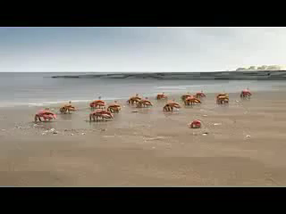
Notes:
----- Meeting Notes (1/3/14 21:12) -----
30 seconds

Slide 19
Team Building
Individually read the handout about Team Building.
Take notes while reading.
Notes:
Individually read the first paragraph of the Wikipedia definition of Team Building and take notes of anything that stands out to you.
As mentioned before and as you read in this article, team building has great rewards for your youth group. Let’s try one on our own.
----- Meeting Notes (1/3/14 21:15) -----
5 minutes

Slide 20
Team Building Activity
Let’s Play Catch!
Notes:
Diana leads Group Activity
In your packet, we have provided for you the Basic Components to run a successful team building activity. This can help you in facilitating your own team building activities locally. At the end of this conference, there will be a drawing for a Team Building Activities Book from which this activity was taken.
If you need help, feel free to email us with any questions or concerns that may arise. If you need help getting started, we can also help out.
----- Meeting Notes (1/3/14 21:15) -----
20 minutes

Slide 21
Reflection
Questions and Answers & Parking Lot
Notes:
Now, let’s take a look at our Parking Lot for Questions and Answers. If you have written down something already but did not put it up, please raise your post-it and someone will collect it.
(If there are no more questions to be answered in the Parking Lot, we have a few more minutes to do so verbally.)
We hope this has been a positive experience for you, and you have walked away with strategies on how to build unity and open, honest communication among your youth group.
Through our experience in the business and education field, we have seen the benefits reaped from practicing these strategies. Again, the comfort level of facilitating will increase with practice. We hope you take the time to try them out.

