Slide 1
COMMUNITY SERVICE AND OUTREACH
Joshua Alvarez

Slide 2
Social Norms
Individually, on a post-it note, write 3 things that will help you learn today
In your group, share out and collectively come up with 3 items to contribute
One representative shares to the facilitator to post the norms on wall

Slide 3
Roles and Responsibilities
Facilitator: Helps direct conversation and encourages all to participate
Recorder: Writes comments down from group
Timekeeper: Ensures everyone is staying on task with time
Reporter: Share out what group has collaboratively come up with

Slide 4
Opening Activities
Appointment THINK
Take a sheet of paper write THINK vertically
Each person stands and finds someone they don’t know (5 total) to fill in their clock
T -
H -
I -
N -
K -

Slide 5
Becoming an Externally Focused Youth Group

Slide 6
Community Needs
What does your community NEED?
2 minutes: Jot your ideas down in your binder
Reminders:
BE SPECIFIC to your community, school, neighborhood, work place, etc.
Think outside “spiritual” needs only – we already know they need Jesus
Share Out

Slide 7
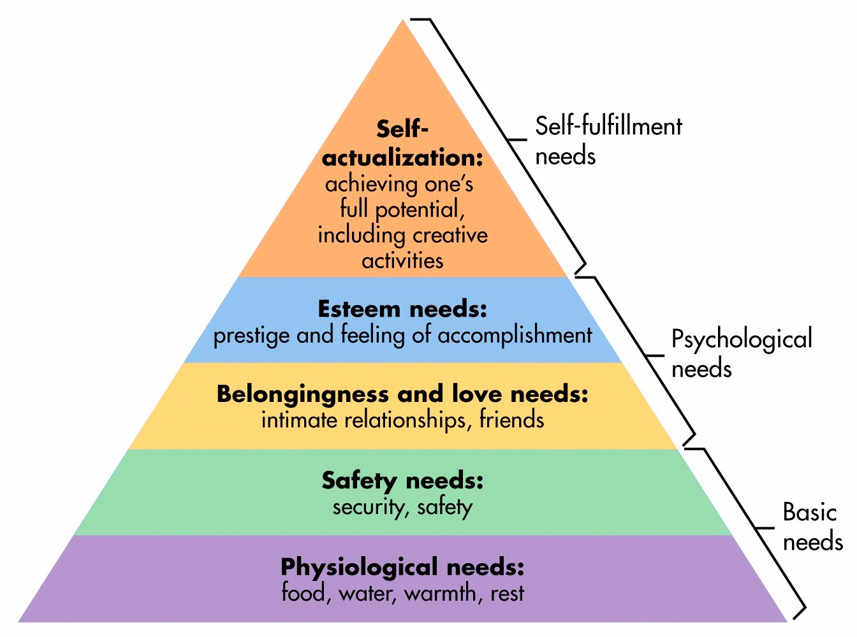
Community Needs
What does your community NEED?

Slide 8
“Seek the peace and prosperity of the city to which I have carried you into exile. Pray to the Lord for it, because if it prospers, you too will prosper.” Jeremiah 29:7

Slide 9
Jigsaw Activity
“First Steps to Becoming an Externally Focused Youth Group”
Facilitator: Assign chapters to group
Timer: Warn the team when 1 minute is approaching (will have 5 minutes to read)
Recorder: Tear poster paper into 8 sections
Read through your assigned chapter and write your summary on your piece to share to group
Share Out:
Facilitator: Allow individuals to share to group
Timer: Stick to 1 minute summaries

Slide 10
Jigsaw
Introduction: Building Bridges
One: What is our current view of outreach?
Two: What is our current ministry programming?
Three: How are we preparing people for externally focused ministry?
Four: What are the needs of our city?
Five: Who can we partner with for community transformation?
Six: How can we get everyone involved?
Conclusion: Fear of Heights

Slide 11
Jigsaw Close
2 minute reflection
How do you feel about becoming an externally focused youth group?
What are some things you know you can do right away back home?
What are some challenges you know you will face?

Slide 13
Think. Plan. Execute
Planning for excellence. Using Resources. Delegating Work.

Slide 14
“In the beginning was the Word, and the Word was with God, and the Word was God.” John 1:1

Slide 15
Introduction
Word in the Greek is “Logos”
Things which are put together in thought, having been thought - Thinking.
In the beginning was the “thought” and the “thought” was with God, and the “thought” was God… and the “thought” was made flesh, and dwelt among us…” John 1:1, 14
The mind is the birthplace of reality
Skyscrapers, Bridges, Art, Music, and so on are all birthed in the mind.
William Lamb had to THINK of the empire state building before it became the largest standing building in the world
The Wright Brothers had to THINK of flight before the first plane was to ever take flight
What are you THINKing?

Slide 16
Table Activity
Considering the needs of your neighborhood, school, community, etc.
2 minutes - Individual
Develop creative methods of serving your community in multiple facets
5 minutes - Table
Choose 1 representative in your group to write the ideas shared out in your group on poster paper
Share out among your group your AWESOME ideas
Comment on ideas that are being shared

Slide 17
Gallery Walk
Tape your ideas onto the wall
Take 3 post-it notes
Draw a Smiley Face ☺
Draw an Exclamation Mark !
Draw a Question Mark ?
Walk around the room and read the ideas shared by the other groups
Place a smiley for an idea you also wrote
Exclamation Mark for something you

Slide 18
7 Secrets of Excellence
Individually read: “The Seven Secrets of Strategy Executing Excellence.”
Time keeper keep track of time
As you read, make notes of each section (1-7) and how that strategy applies to you personally.
Personal Reflection
What areas are you excelling in?
What areas can you improve in?
Break each point down and hear comments regarding each strategy

Slide 19
Table Activity
Planning an Activity:
Choose an idea you have at your local table to plan:
In your group, discuss how you would plan it to the “T”
Consider all the staff you would need, materials, who to contact, deadlines, etc.
Be sure to take everything step by step
Record your plan on poster paper and post when finished

Slide 20
Resources
Blood Drive
http://www.redcrossblood.org/hosting-blood-drive
Food Drive
http://createthegood.org/toolkit/organize-food-drive/overview
5K Run or Walk-a-thon
http://www.active.com/running/articles/how-to-organize-your-first-race
Tutoring Program
http://www.readingrockets.org/article/112/

