Slide 1
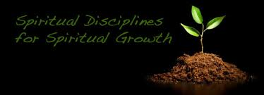
HELPING OTHERS IN THEIR SPIRITUAL DEVELOPMENT
IDCN MOP Think 2014
Elder Israel Carlos

Slide 2
THE 4 BIBLICAL DISCIPLINES FOR SPIRITUAL GROWTH
GROWING IN GOD THROUGH HIS WORD
GROWING IN GOD THROUGH PRAYER AND FASTING
GROWING IN GOD THROUGH WORSHIP
GROWING IN IN GOD THROUGH FELLOWSHIP WITH OTHER BELIEVERS

Slide 3
GROWING IN GOD THROUGH HIS WORD
as newborn babes, desire the sincere milk of the Word, that ye may grow thereby, 2 Peter 2:2 (21 century KJV)d. 2 Tim. 3:16-17
The Word of God’s gives us nourishment for growth. We cannot grow without God’s Word.
We must abound in God’s Word. Col. 3:16
In order to help the Youth grow spiritually we must get them into the Word: Read, study, memorize and meditate in it! Psalms 1:2
Jesus taught his disciples the Word. Mat. 5:1-2
WE MUST USE JESUS’ METHODS

Slide 4
GROWING IN GOD THROUGH PRAYER
Just as we must listen to God daily through His Word, so we must talk to Him daily if we are to grow; have you developed the habit of praying regularly? Heb. 4:16, Phil 4:6-7,
We cannot grow spiritually without prayer!
Both David and Daniel prayed 3 times daily. Psalms 55:17, Dan. 6:10
Jesus taught his disciples to pray. Luke 11:1
in order to help the Youth grow we must
get them into prayer.
WE MUST USE JESUS’ METHOD

Slide 5
GROWING IN GOD THROUGH FASTING
Spiritual disciplines help believers grow in their walk with Christ. Fasting is one of the most misunderstood and one of the least practiced of the spiritual disciplines, but the words of Jesus the words of Jesus makes it clear that fasting is important. Mat. 16:18
We cannot grow spiritually without
the discipline of fasting!
Jesus taught his disciples to fast.
MAT. 4:2, Dan. 10:3
In order to help the Youth grow
we must get them into fasting.
WE MUST USE JESUS’ METHOD!

Slide 6
GROWING IN GOD THROUGH WORSHIP
Worship and praise bring us closer to God and helps us to grow spiritually. Eph. 5:16-20, Col. 3:16
As we develop the habits of daily Bible reading and prayer, let us also develop the habit of singing praises to God daily if we seek to grow! Acts 16:25
We cannot grow spiritually without worship.
In order to help the Youth
grow we must get them into worship.
John 4:23-24
Let’s use Jesus’ method.

Slide 7
GROWING IN GOD THROUGH WORSHIP
Worship and praise bring us closer to God and helps us to grow spiritually. Eph. 5:16-20, Col. 3:16
As we develop the habits of daily Bible reading and prayer, let us also develop the habit of singing praises to God daily if we seek to grow! Acts 16:25
We cannot grow spiritually without worship.
In order to help the Youth grow we must get them into worship.
John 4:23-24
Let’s use Jesus’ method.

Slide 8
GROWING IN GOD THROUGH FELLOWSHIP
Meet together with other believers regularly. The reason we attend church or gather with other believers regularly (Hebrews 10:25) is for teaching, fellowship, worship, communion, prayer and to build one another up in the faith (Acts 2:42-47). Participating in the body of Christ is fundamental to spiritual growth
The Lord sees high purposes in our “one anothering,” which include edifying, admonishing, praying for, and encouraging the family of faith, while stimulating them to love and good deeds.
Romans 14:19; 15:14; James 5:16; 1 Thessalonians 5:11; Hebrews 10:24.
In order to help the Youth grow we must get them to fellowship with one another.
Iron sharpens iron, and one man sharpens another. Prov. 27:17
We cannot grow without fellowship. Let’s use Jesus’ method.

Slide 9
Let’s discuss spiritual growth…specifically yours.
I’m always interested in spiritual growth, because…well…that’s kind of what I do!
Help me by telling me some of your spiritual growth process.

Slide 10
TO HELP YOU THINK, CONSIDER ANSWERING SOME OR ALL OF THESE QUESTIONS:
Are you closer to God today than you were a year ago?
If not, what changed?
Is yes, what did you do differently?
What helps you most to grow spiritually?
Was there a time in your life where you felt the closest to God?

Slide 11
TO HELP YOU THINK, CONSIDER ANSWERING SOME OR ALL OF THESE QUESTIONS:
6. Who is mostly responsible, in your opinion, for your spiritual growth?
7. Do you practice any spiritual disciplines, such as Bible reading, prayer, fasting, tithing, etc.? If so, what do you do?
8. What changes would you need to make to grow more spiritually?

Slide 12
HOW DO YOU MEASURE SPIRITUAL GROWTH?
meet many people frustrated with their spiritual life. Often I find they are measuring the wrong things. They tend to measure their day-to-day activities, rather than their progress over time. to encourage you to measure outputs, not inputs when evaluating your spiritual life.

Slide 13
If you measure only inputs of your spiritual growth…such as…
How many times you read your Bible
How many minutes a day you pray
How many people you invite to church
You might not get a complete sense of your spiritual life.

Slide 14
If you measure the outputs of your spiritual growth…such as…
Are you becoming more patient?
Are you learning to love people that hard to love?
Do you desire to be more like Christ today than you once desired?
You can discern if you are really growing spiritually

Slide 15
When I measure the outputs, the results of my faith, I can truly determine if I am growing to be more like Christ.
Discipline helps develop spiritual fruit, and I believe in practicing private disciplines that help grow your faith (inputs), but the discipline is not the goal, the fruit is the goal (outputs). Jesus didn’t say His followers would be known by the number of disciplines they can keep. Jesus said we would be known by our fruit.

Slide 16
AREAS OF GROWTH FOR THE YOUTH
Knowledge. 2 Peter 3:18, Phil. 1:9
Character. Gal. 5:22-24, 2 Pet. 1:5-9
Leadership. 1 Tim. 4:12
Ministry. Eph. 4:11
Gifts. 1 Cor. 12:7-10

Slide 17
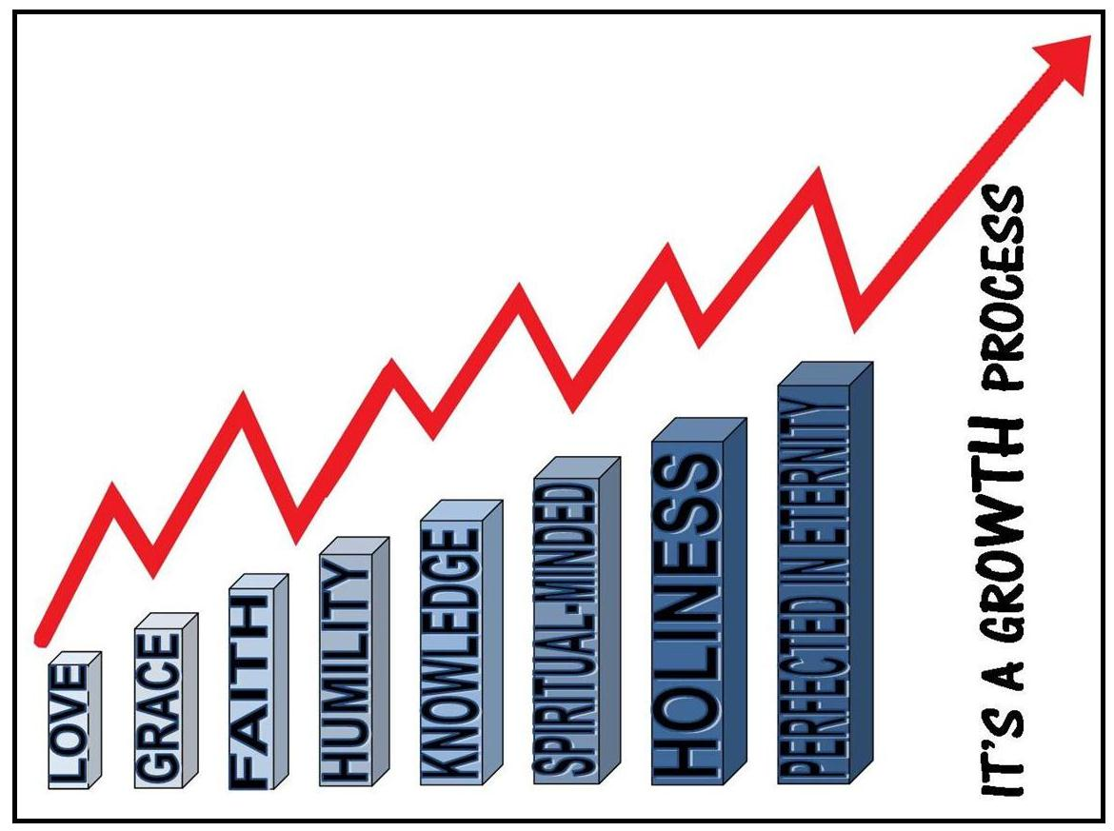

Slide 18
Col. 1:9-10
And so, from the day we heard, we have not ceased to pray for you, asking that you may be filled with the knowledge of his will in all spiritual wisdom and understanding, so as to walk in a manner worthy of the Lord, fully pleasing to him, bearing fruit in every good work and increasing in the knowledge of God.

Slide 20
GROWTH ACTIVITIES AND PROGRAMS FOR THE LOCAL CHURCH
What do you believe is spiritual growth?
What contributes to a person’s growth the most?
What effective spiritual programs and activities have you implemented in the local church?
How do you implement the spiritual disciplines of the Word, Prayer, Fasting, and Fellowship in your local church in a way that involve and attract the youth?
What growth evidence have you seen in your local youth?
What changes do you need to make to grow more spiritually?
Are there any comments or thoughts you have about what we should do to spur the to become growing followers of Jesus Christ?

